Slide 1


PANIMALAR ENGINEERING COLLEGE
DEPARTMENT OF COMPUTER SCIENCE AND ENGINEERING
CS8811 PROJECT WORK
UNIVERSITY PROJECT VIVA
TRANSPARENT VOTING SYSTEM
Mrs. V. Anitha Moses, M.E.,
Dr. N. Pughazendhi, M.E., Ph.D.,
C12
By
Sudharsan R (211418104271),
Vimal M (211418104311) &
Yoganandan S (211418104315)
GUIDE NAME:
COORDINATOR:
BATCH NO:

Slide 2
Introduction
The aim of this project is to create a decentralized transparent voting and analysis system that can be implemented with blockchain to provide an efficient and highly secure justifiable method of implementing election systems in countries where traditional physical voting with gameable securities is used, increasing the chances of rigged elections.
Our dApp allows voters to vote from the comfort of their own homes, saving time and reducing the number of false votes registered.

Slide 3
Literature Survey
TITLE | DESCRIPTION
Azaria, Asaph, Ariel Ekblaw, Thiago Vieira, and Andrew Lippman. "MedRec: Using Blockchain for Medical Data Access and Permission Management." In Open and Big Data (OBD), International Conference on, pp. 25-30. IEEE, 2016. | In this paper they have used the technique but for different use case which we have taken it as an inspiration for us all on the momentum for the development of the p2p based voting decentralized system.
Nakamoto Satoshi, inventing bitcoin, implementing the first blockchain, deploying the first decentralized digital currency “A Peer-to-Peer Electronic Cash System” original 20 March 2014. | There were at least 4 (four) important problems raised in this election i.e., the problem of logistics distribution, the duration of the ballot counting that is too long, the inconsistent regulation of vote counting, and the error in votes recapitulation. Blockchain technology can be a solution to deal with those problems.

Slide 4
Problem Statement
Many elections conducted on electronic voting machines are hand-counted, and many jurisdictions that use lever voting machines tally absentee ballots by hand.
These devices are not meant to endure a long time, they must be serviced on a regular basis by only trained mechanics. Apart from equipment maintenance issues, there has also been a problem with only a small fraction of individuals voting.
For verification, most present E-voting applications rely on government-issued information, which is not the most effective means of authentication and it is also difficult to keep it secure. There is also the possibility of casting multiple ballots. To tackle these challenges, we've implemented a decentralised database and a smart contract in our dApp, which stops voters from casting duplicate votes.

Slide 5
Existing System
For an election process to take place, the existing blockchain voting system comprises three phases: authentication, voting, and counting. Where several users' authentication and voting can be done in concurrently, and the counting phase begins only after the voting phase is completed.
Proposed System
In the proposed system, the authentication phase will be predefined, and the voting and result phases will be run simultaneously, allowing the proposed system to realize the main notion of openly showing live results to each and every voter. The web application in the proposed system is also built utilizing the React8 framework, which makes the system scalable.

Slide 6
Development Environment
HARDWARE REQUIREMENTS:
Processor : Pentium Dual Core 2.00GHZ or above
Hard disk : 10 GB or above
RAM : 2GB (minimum)
SOFTWARE REQUIREMENTS:
OS : Windows 7 or above
IDE : Visual Studio Code
Backend : Node Js, Solidity
Frontend : React

Slide 7
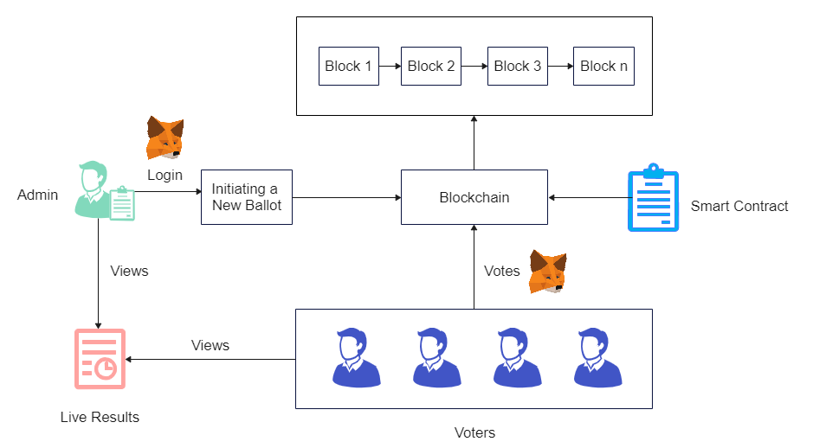
System Architecture

Slide 8
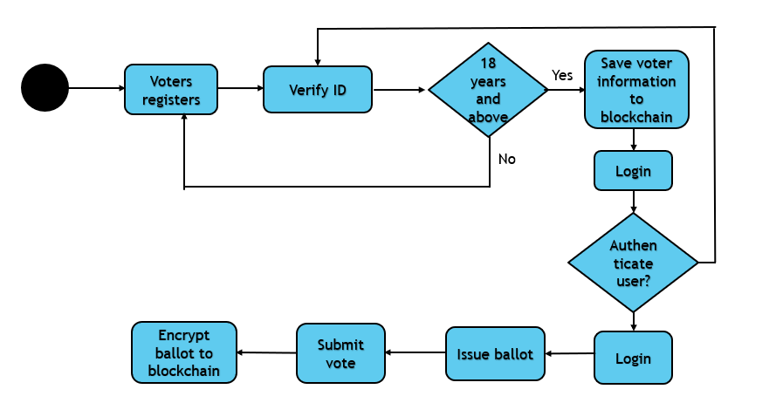
Flow Chart

Slide 9
ER Diagram
Voter ID
Reg ID
Name Info
Report No
User
Vote
Transparent Voting System
Age Info
Upload Vote in ballots
View Live Status
Voter Name

Slide 10
UML – Use Case Diagram
Registration of User ID
Save Information to blockchain
Login and verification
Issue ballot
User
Algorithm
View live status and Submit vote
Encrypt the ballot into blockchain
Output

Slide 11
UML - Activity Diagram
USER | VOTING SYSTEM
Login
Registration of voter
Verification
Save information to blockchain
View live status
Issue ballot
Submit vote
Encrypt ballot to blockchain

Slide 12
UML – Collaboration Diagram
Reg ID
Give Information
Voter
Smart Contracts
Dataset
Collaborating the Dataset
Predicting the Output
User Interface
Submit and Encryption
Issue Ballot
Verification of Voter ID
Preprocessing

Slide 13
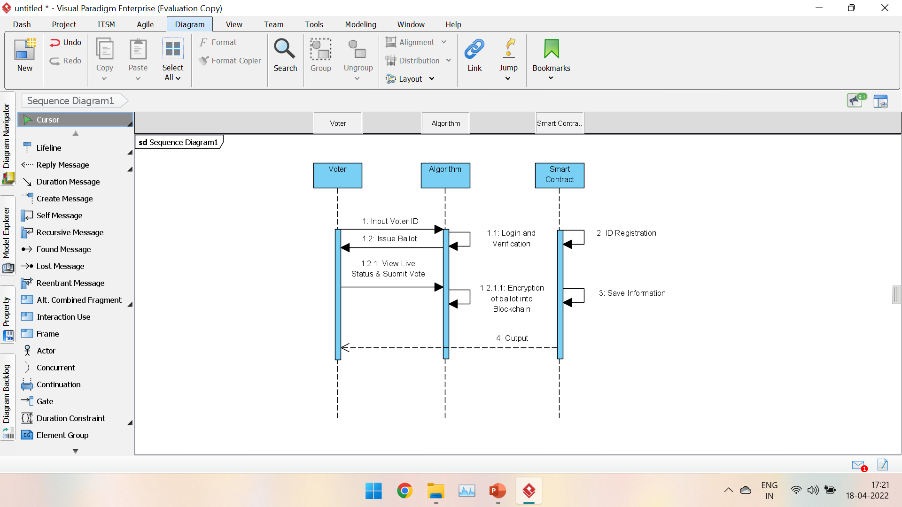
UML – Sequence Diagram

Slide 14
Module Description
Login:
Unlike traditional web2 applications where the user logs in to their account using a username and a password, web3 applications use wallets to connect to a user account. The public key of an account uniquely identifies the user whereas the private key is used for authorization. In our voting dapp, we use meta mask wallet which is available as a browser extension. To log in, the user has to simply connect the app to an account from the wallet.
Initiating a new ballot:
Only admin can start a new ballot by specifying the information regarding the ballot and by authorizing the transaction using the wallet. The transaction is sent to the blockchain network and upon success is appended to the ledger permanently. The ballot creator has to add a list of addresses (public address of user accounts) that are eligible to vote.

Slide 15
Module Description
Voting Process:
A user who is eligible to vote can connect their accounts in a similar manner using metamask. If a match is identified, the voter is given a list of candidates to choose from, with the option to vote against them. By signing a transaction in the wallet, the user's vote is recorded on the ledger as a transaction is delivered to the network. To this end, a successful vote cast is considered as a transaction within the blockchain of the voting application. Furthermore, once a vote is made, the same voter cannot cast several votes.
Live Results:
Users can access the ballot results at any time. A cast vote is recorded in data tables at the backend of the database and added to the blockchain as a new block (after successful mining). The proposed system assures that each person can only vote once. During execution, the asset is transmitted to the address, and a transaction hash containing the vote transfer is produced.

Slide 16
Testing
S.NO. | Test Cases | Expected Output | Actual Output | Status
1. | Admin creates ballot. | All eligible voters will see the ballot that has been created. | The ballot was prepared and displayed to all voters successfully. | PASS
2. | Admin adds eligible voters. | Voters with voting ID will be added successfully. | Accounts for eligible voters will be successfully generated. | PASS
3. | Voters login in to their account. | When genuine voter credentials are entered successfully. Voters can use their voting ID to log in. | The voter's login credentials have been confirmed, and they have been successfully entered into their account. | PASS
4. | Voters can view live polling results. | Before casting their votes, voters can check live results. | The live results were successfully displayed. | PASS

Slide 17
Testing
5. | Cast vote. | Voters can cast their vote and observe the results immediately. | Voter’s vote will be reflected in ballot immediately. | PASS
6. | Avoid vote reputation. | When a voter attempts to cast numerous votes, the deployed smart contract should prevent the voter from doing so. | When voters attempt to cast numerous votes, the message "You have already voted" will appear. | PASS
7. | Ends voting on specified time. | After the polling period has ended, voters are unable to vote. | When people attempt to vote after the polling period has ended, they will get the message "Voting concluded." | PASS
8. | Transparent display of results. | Everyone will be able to see the voting results. | The voting results were successfully shown. | PASS

Slide 18
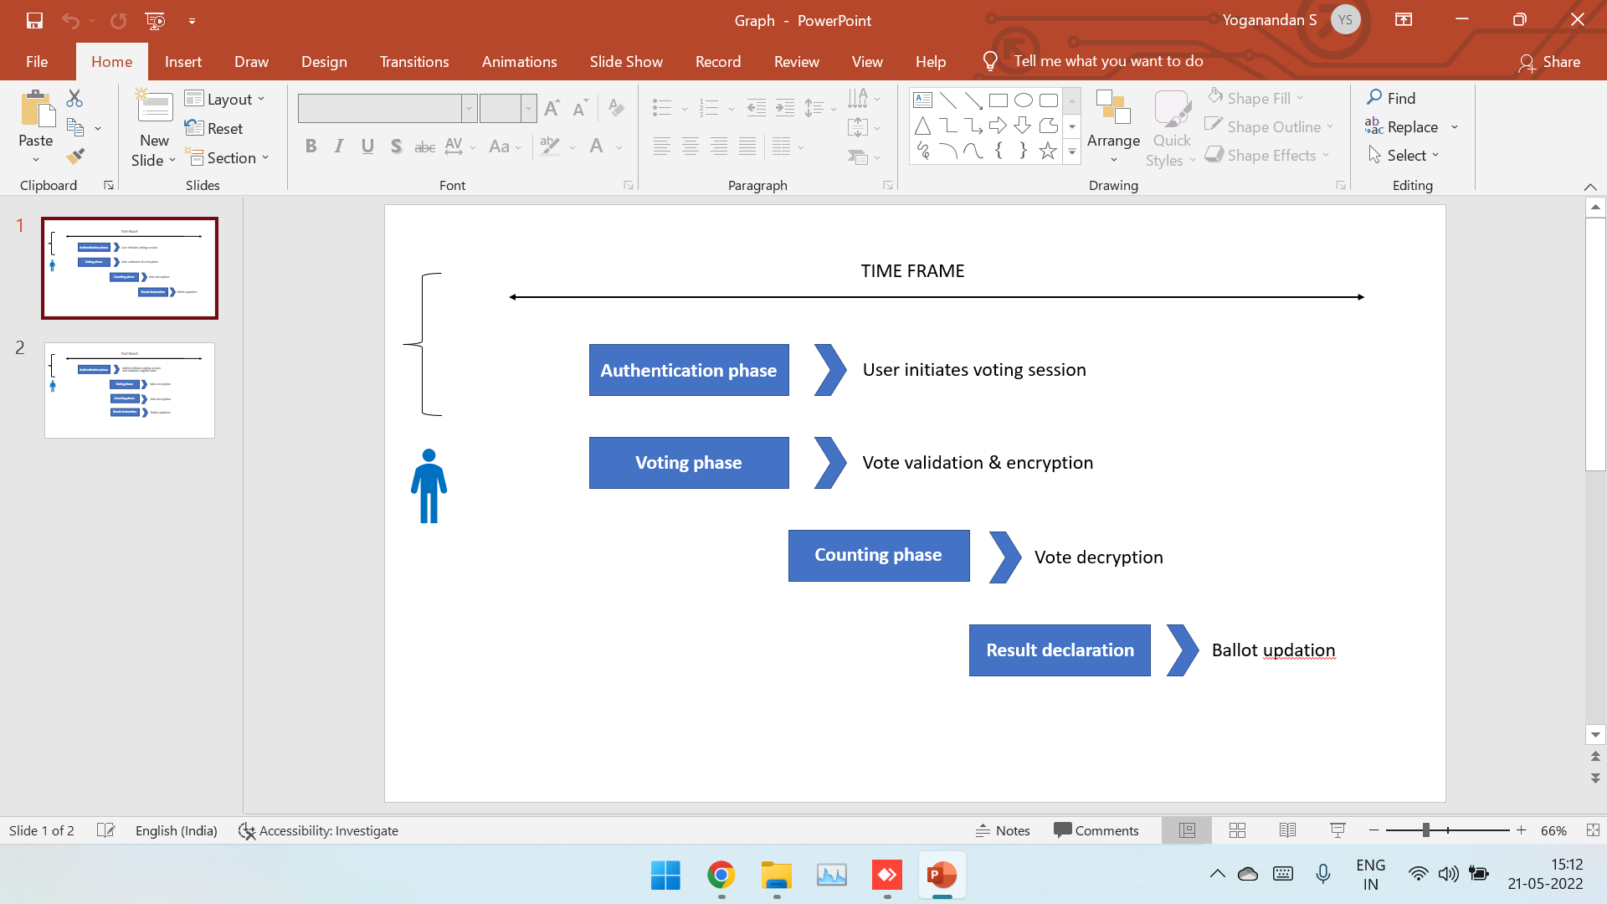
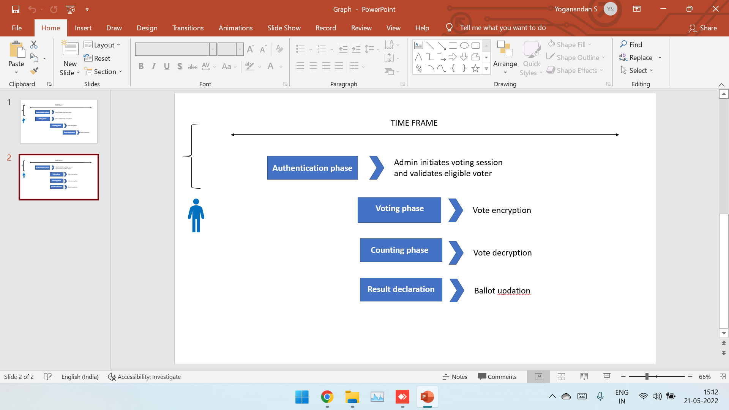
Results
Existing system
Proposed system
The contrast between the present and proposed systems is shown in the above figures. In the proposed system, the authentication phase will be predefined, and the voting and result phases will be run simultaneously, allowing the proposed system to realize the main notion of openly showing live results to every voter. This allows individuals to choose their preferred leader.

Slide 19
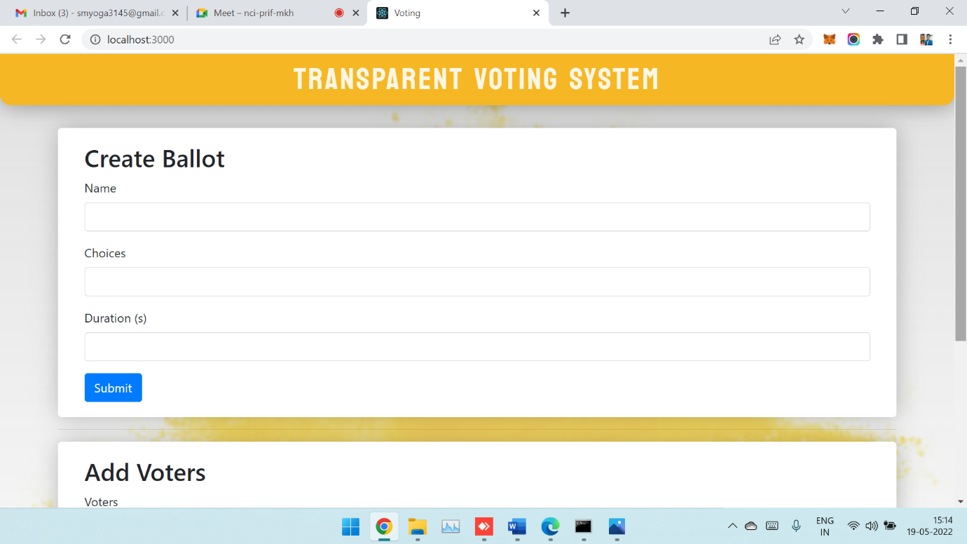
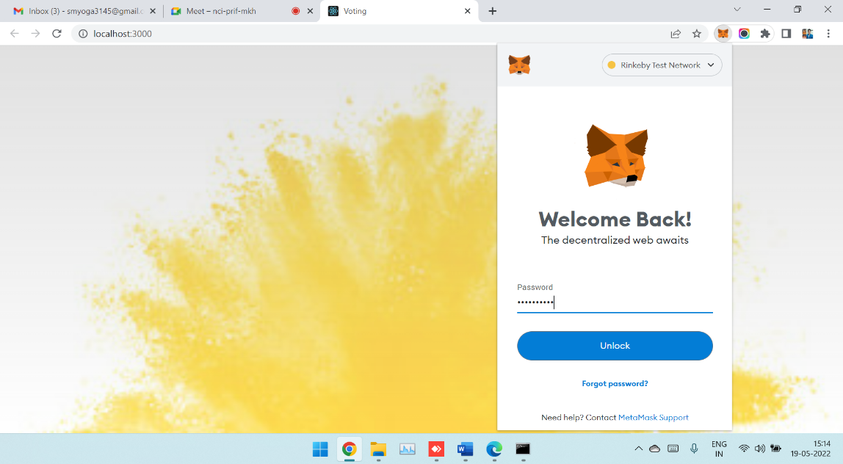
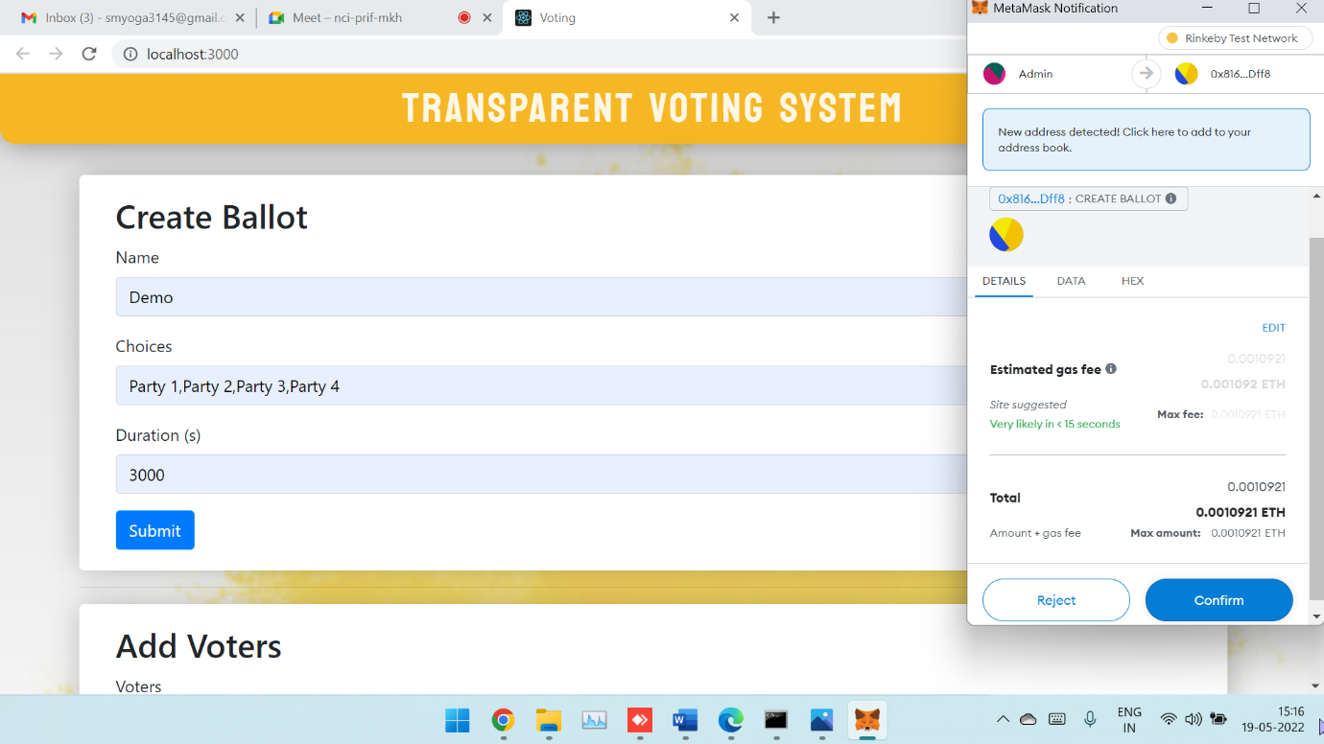
Screenshots
Admin login.
Creation of new ballot.

Slide 20
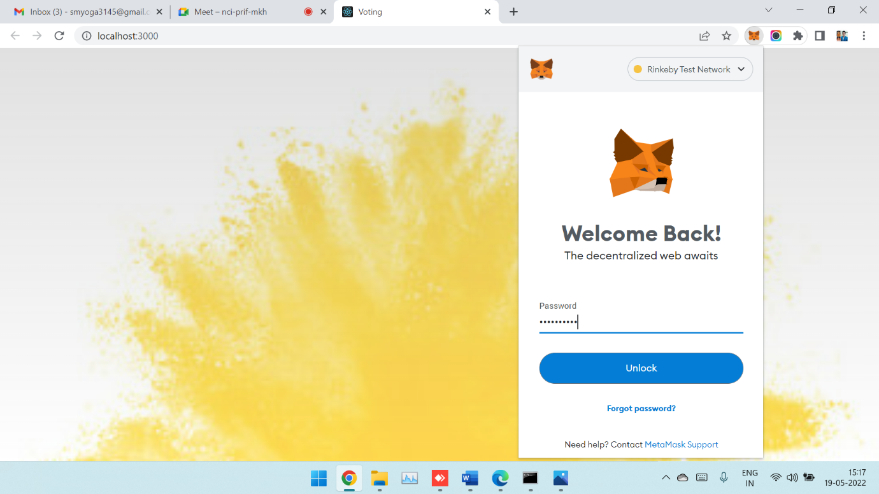
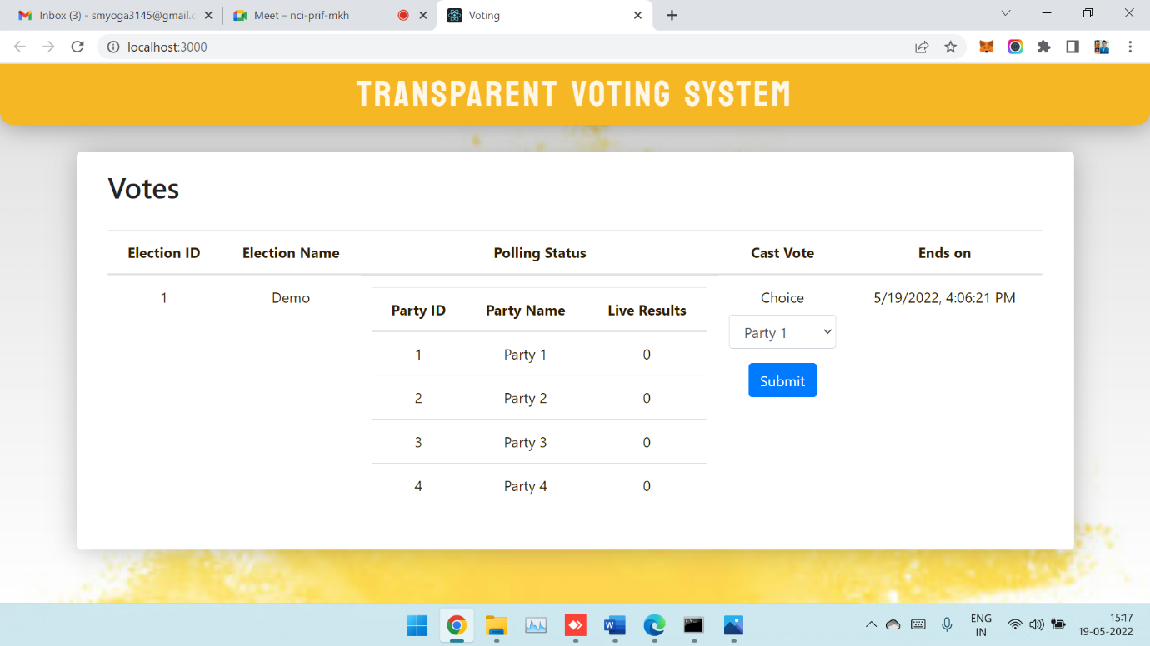
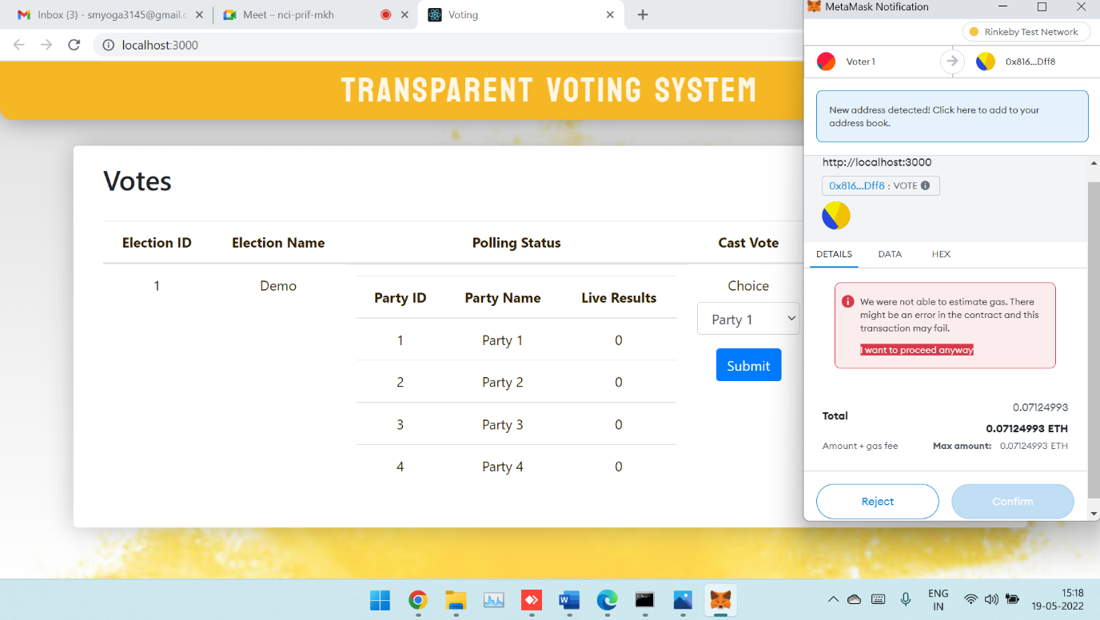
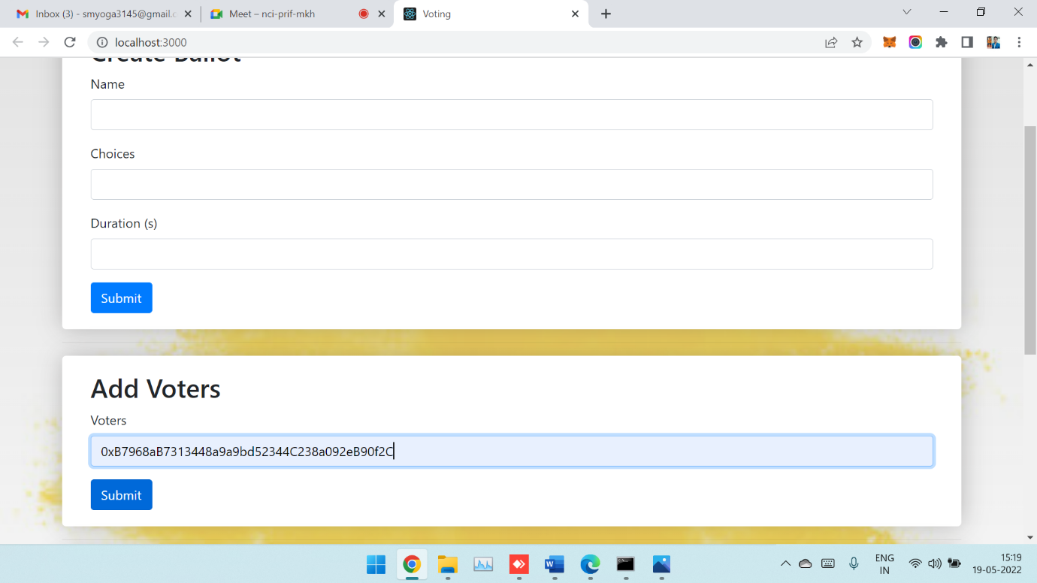
Voter login and ineligible voter prompt.
Add voters.

Slide 21
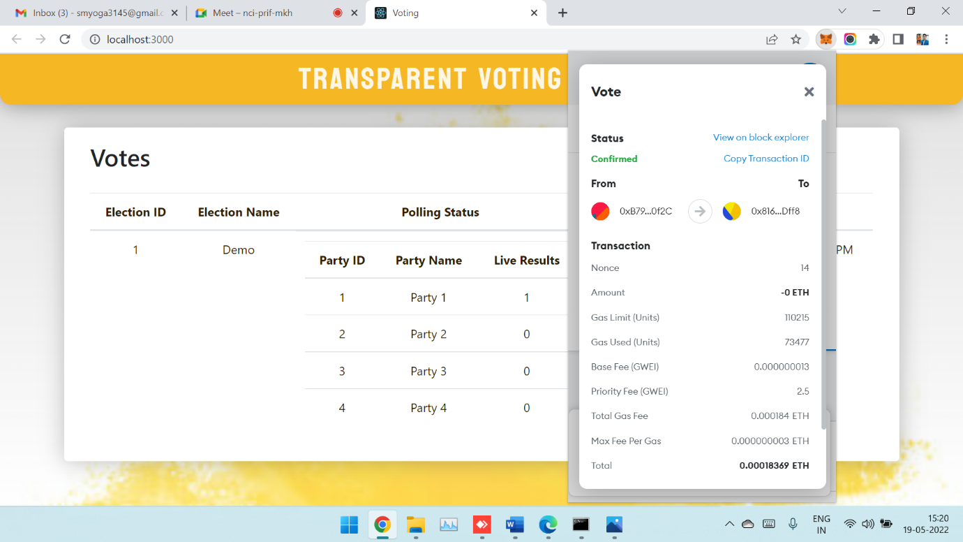
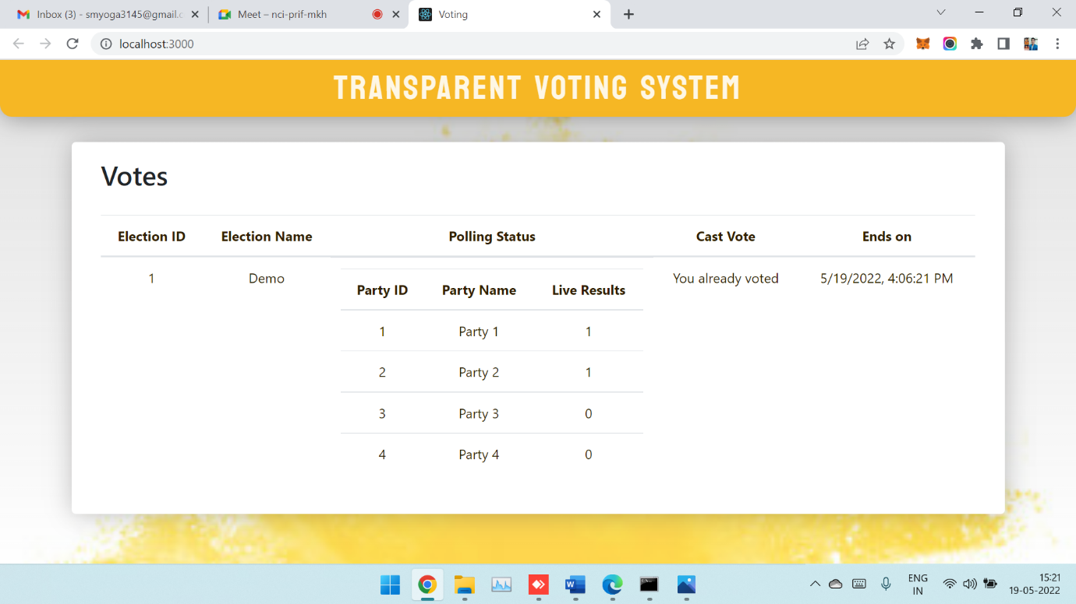
Voter confirmation page with immediate ballot updation.
Restriction of multiple votes from same voter ID.

Slide 22
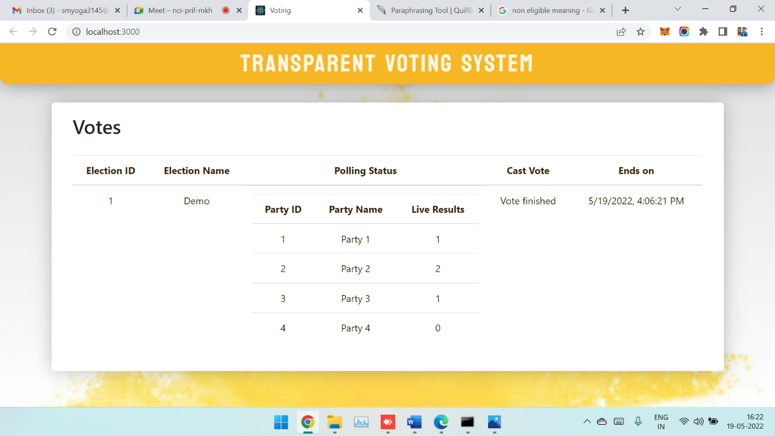
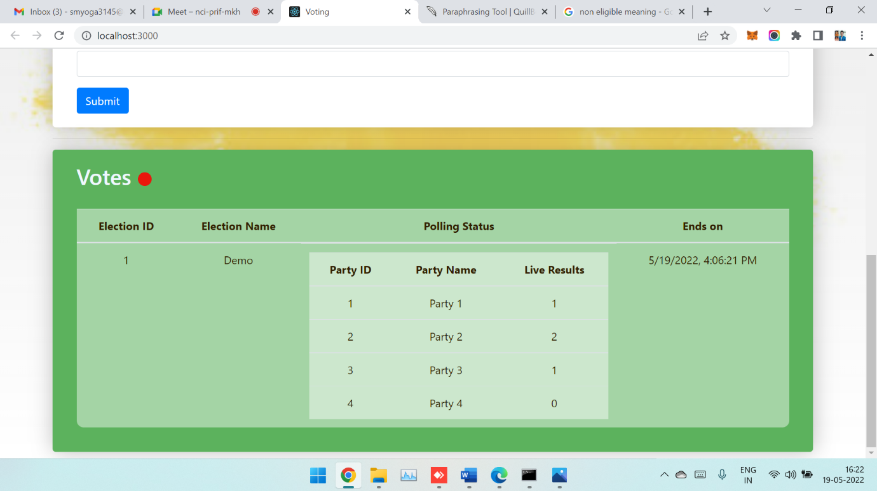
Voter’s page at the end of polling.
Admin’s final result page.

Slide 23
Conclusion
The system is implemented using blockchain and a smart contract. The system will employ candidate or voter information in the voting process. Smart contracts will be used to manage the voting methods and outcomes. This strategy also increases the efficiency of the validation and voting assignment phases.
Face recognition would be a great addition because it improves security and prevents duplicate and forged votes. The application can additionally contain two- factor authentication; this way, even if the voters' credentials are lost, the use of two-factor authentication will prevent proxy votes from being cast.

Slide 24
References
Journals:
[1] Azaria, Asaph, Ariel Ekblaw, Thiago Vieira, and Andrew Lippman. "MedRec: Using Blockchain for Medical Data Access and Permission Management." In Open and Big Data (OBD), International Conference on, pp. 25-30. IEEE, 2016.
[2] Nakamoto Satoshi, inventing bitcoin, implementing the first blockchain, deploying the first decentralized digital currency “A Peer-to-Peer Electronic Cash System” original 20 March 2014.
Websites:
www.google.co.in
www.stackoverflow.com

Slide 25
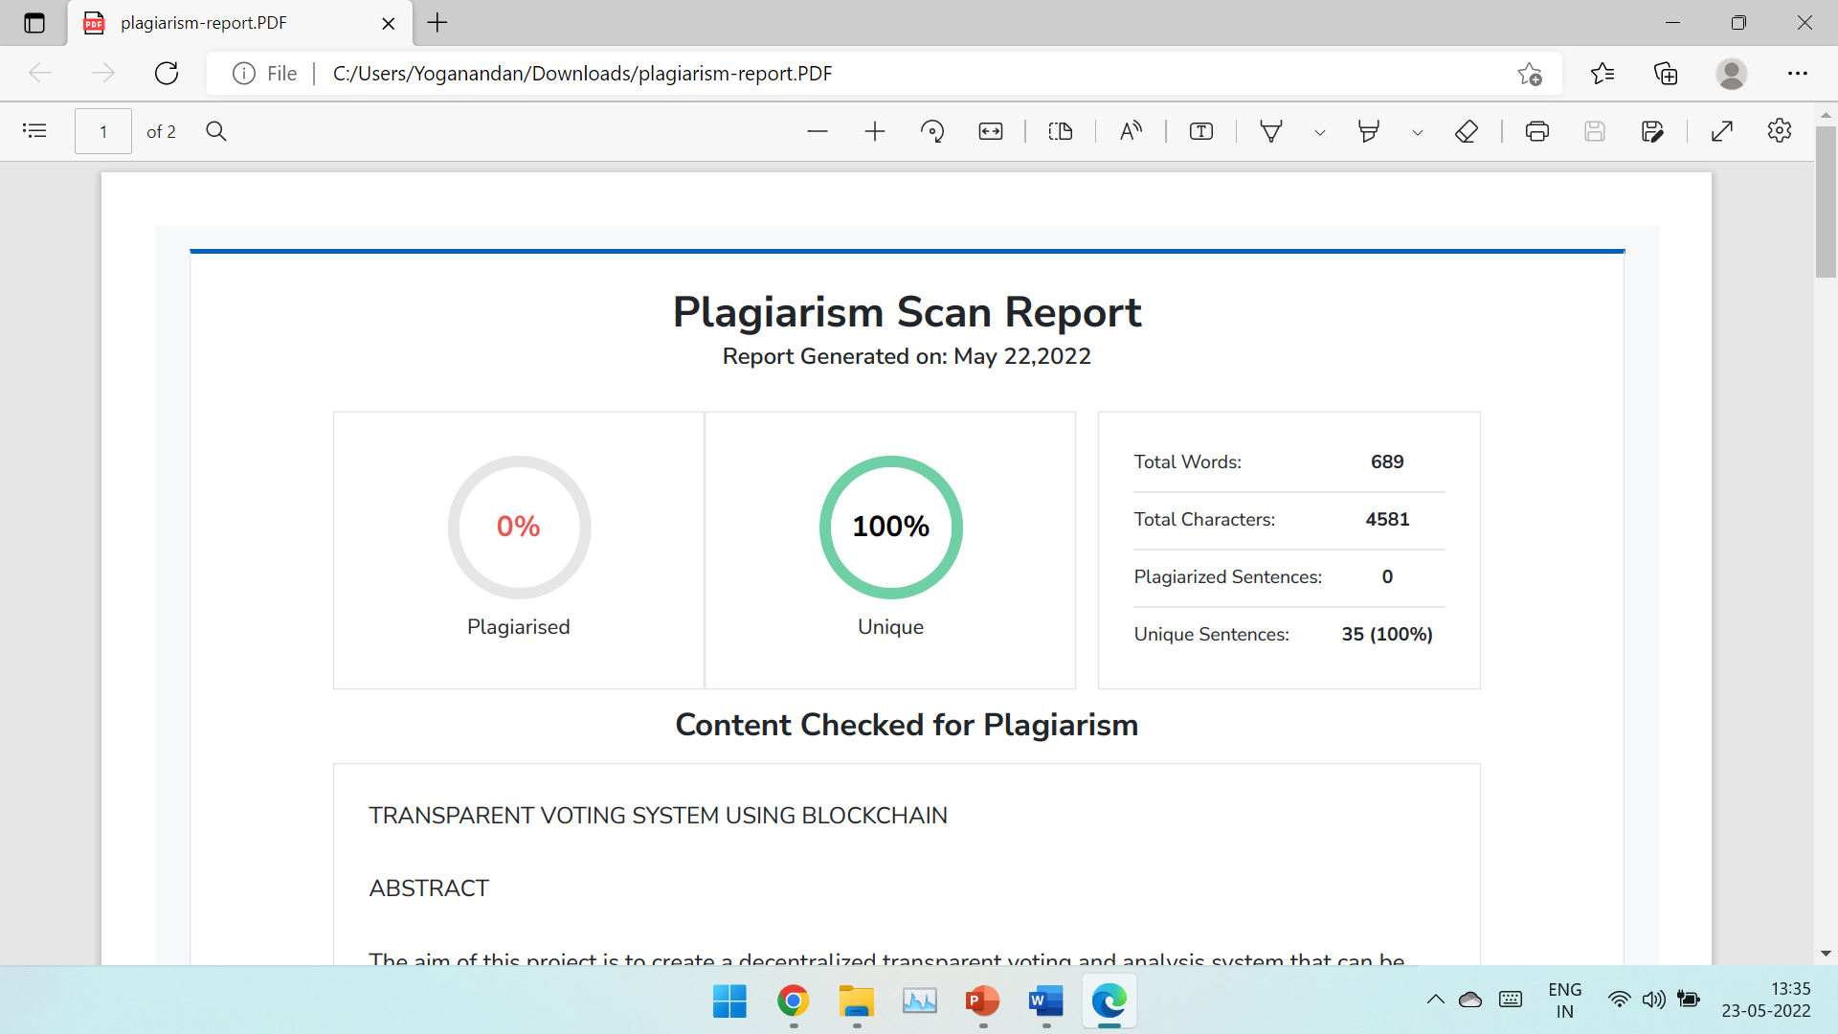
Plagiarism Report

Slide 26
HANK
OU

